Slide 1
Opening a Turkish Restaurant in Bucharest -A capstone project
Gayathri Patri
Feb 2021

Slide 2
Introduction
Problem Statement: What are the possible locations for someone to open a Turkish restaurant in Bucharest.
Bucharest is the capital and largest city of Romania, as well as it’s cultural, financial and industrial centre. It is in the southeast of the country, at 44°25′57″N 26°06′14″E, on the banks of the Dambovita River, less than 60 km (37.3 mi) north of the Danube river and the Bulgarian border.
The city proper is administratively known as the 'Municipality of Bucharest' and has the same administrative level as that of a national county, being further subdivided into six sectors, each governed by a local mayor.

Slide 3
Data Sources
I got the neighborhood data of Bucharest from Wikipedia
I used python geocoder library to get geographical coordinates of neighborhoods.
I used Foursquare API venues explore method to get the venues of given neighborhoods of Bucharest.
I used Foursquare API venues method to get ranks and likes of restaurants by given venue id.

Slide 4
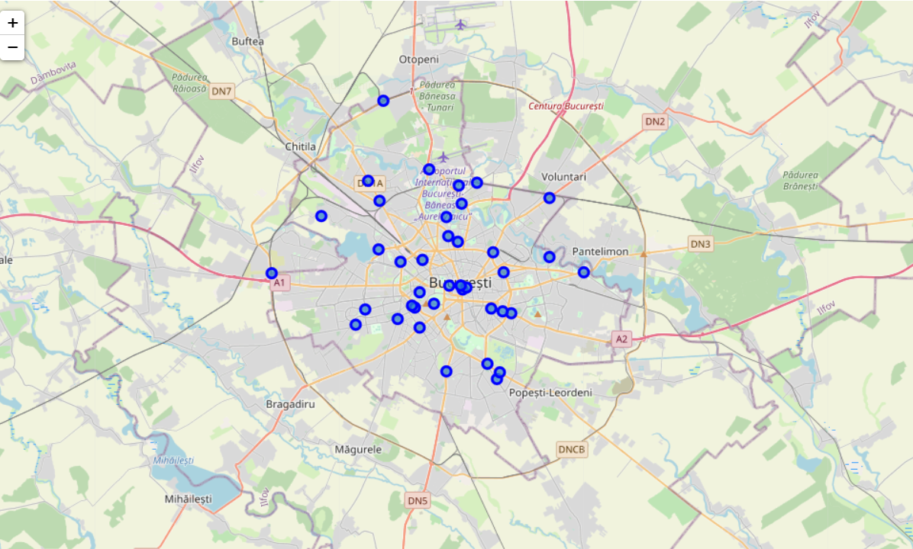
Methodology
I used GitHub repository for code versioning.
The Bucharest data is available with the neighborhood name in Wikipedia. Location information (latitude and longitude) of neighborhoods is taken from geocoder library.
I took neighborhood from Wikipedia and put blue dots on Bucharest map to see centers of neighborhoods. There are 40 neighborhoods in Bucharest.

Slide 5
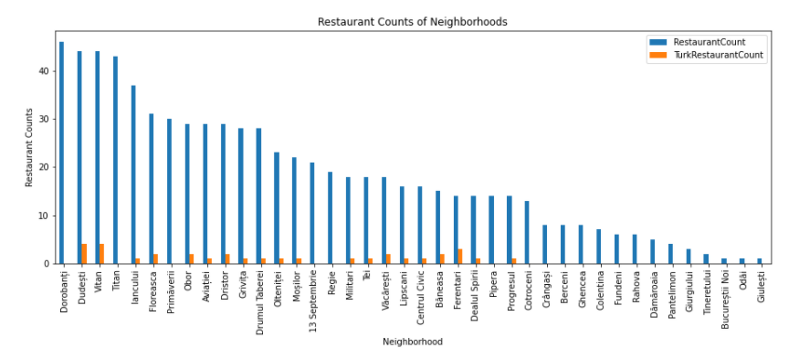
Methodology (cntd.)
By using Foursquare API, I got venue list with 1 km distance to neighborhood's center. There are 215 unique venue categories
I filtered all other restaurants to get Turkish restaurant. We can see from histogram of restaurants that 20 neighborhoods do not have any Turkish restaurant.

Slide 6
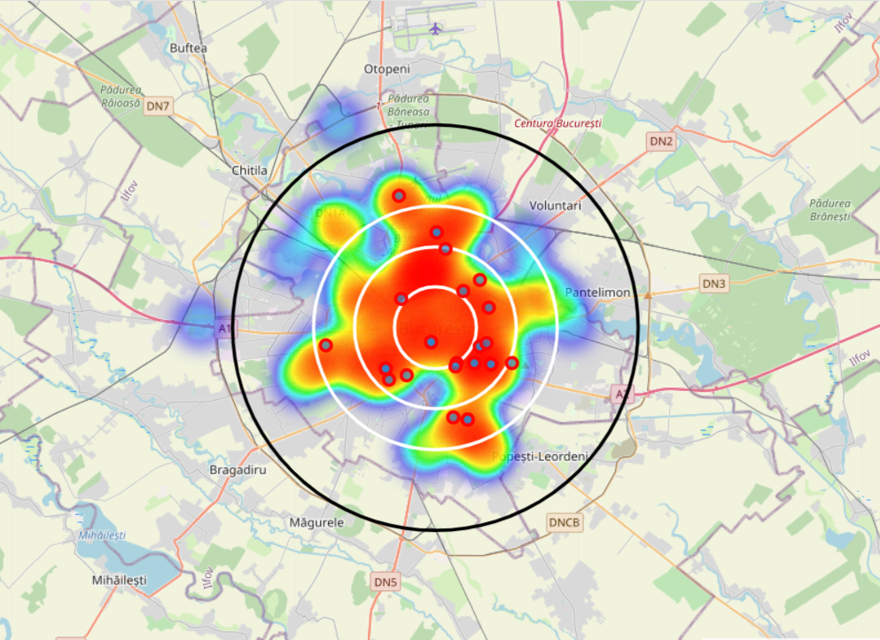
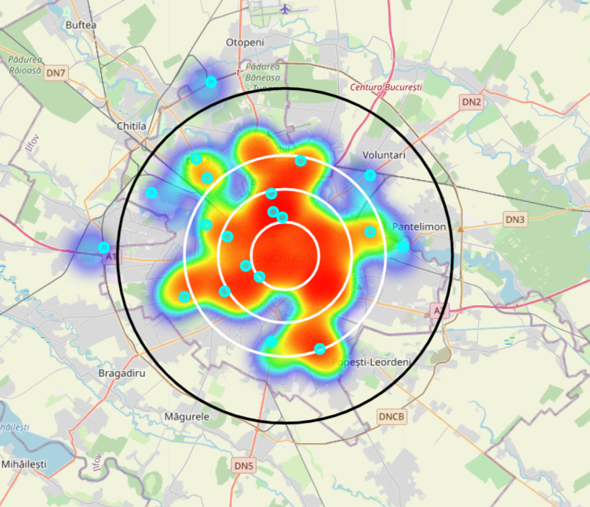
Methodology (cntd.)
I created a heatmap for counts of restaurants in neighborhoods by using Folium library. On heatmap, I used 4 few circles indicating distance of 2km, 4km, 6km and 10km from Bucharest center.
I superimposed the existing blue dots with red markers for Turkish Restaurants and blue circles for Turkish restaurants with rating less than 7 on first map.
I superimposed neighborhoods without any Turkish restaurant with cyan markers in second heatmap.

Slide 7
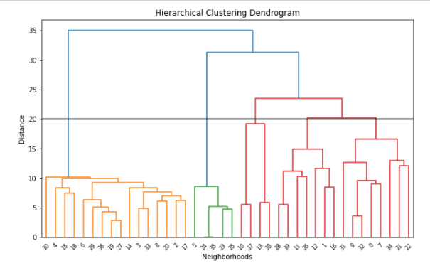
Methodology (cntd.) Clustering
I used Agglomerative Clustering to cluster neighborhoods according to count of venue categories in each neighborhood. According to the below graph, I decided to separate our neighborhoods into 6 clusters (cut at distance of 20, horizontal black line).

Slide 8
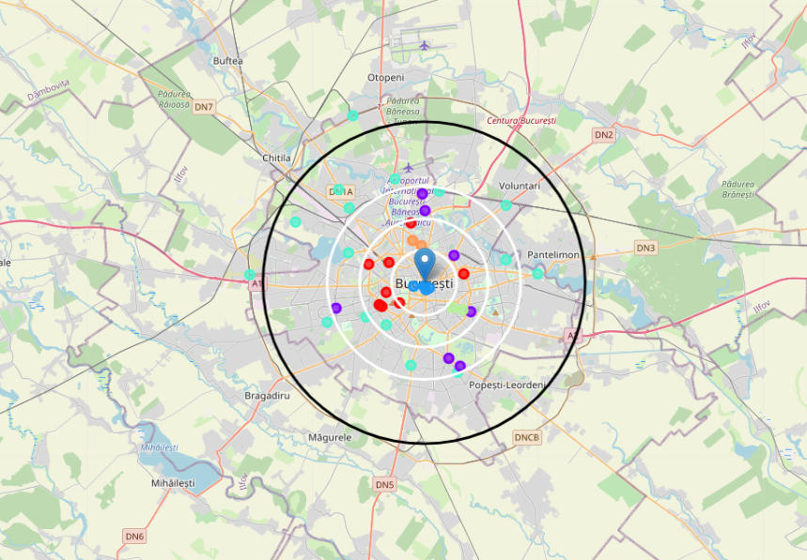
Clustering (cntd.)
Cluster 0 (Red) : Café, Lounge and Supermarket, Restaurant
Cluster 1 (Purple) : Café , Gym, Hotel, Pizza, Bus Station, Pub, Restaurant
Cluster 2 (Blue) : Hotel, Coffee Shop
Cluster 3 (Cyan) : Supermarket/Furniture/Arts&Crafts Stores, Gym, Salons, Pharmacy, Deserts/Burger/East European joints, Bus Station, Café, Soccer Field, Romanian Restaurant
Cluster 4 (Green) : Café, Gym, Pizza, Supermarket
Cluster 5 (Orange) : Café/Coffee shop

Slide 9
Results
I investigated that Turkish restaurant counts in Bucharest is 4.68% with
total number of restaurants: 470 and total number of Turkish restaurants: 22
From bar chart, I observed that
Dorobanti is the neihgborhood having high number of restaurants, but has very less Turkish restaurants.
Dudesti is also having the high number of restaurants , but there is not even single Turkish restaurant.
Giulesti and Odai are the neihgborhoods having least number of restaurants.
20 neihgborhoods do not have any Turkish restaurant. we can choose one of these to open restaurant.

Slide 10
Results (cntd.)
From heat maps, we can see that there are
Many restaurants in 4 km radius from the center
Good amount of restaurants between 4-6 km from the center
Not many restaurants after 6 km
Turkish restaurants are represented with red superimposed on blue dots. Blue dots are Turkish restaurant with rating <7
Turkish restaurants are located in South, North , East, between 2-4 Km distance around center
There are no Turkish Restaurants in West Part.
Four Turkish restaurants got low ratings which means people does not prefer these restaurants too much and so there are high chances, if any Turkish restaurant opens there, may receive good profit.

Slide 11
Discussion
Clusters 0,2 and 5 appears to be having less commercial market.
Clusters 1,2 and 3 has one or the other kind of hotels.
Clusters 1,3 and 4 clusters have Italian Joints.
Cluster 3 appears to be crowded most of the times depending on the number of different kind of avenues there.

Slide 12
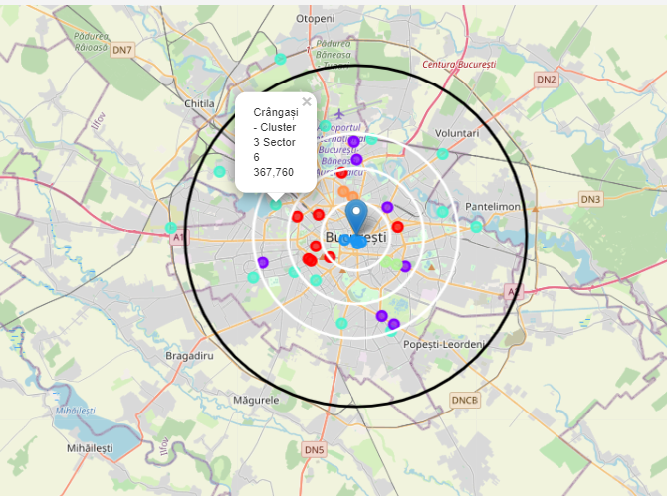
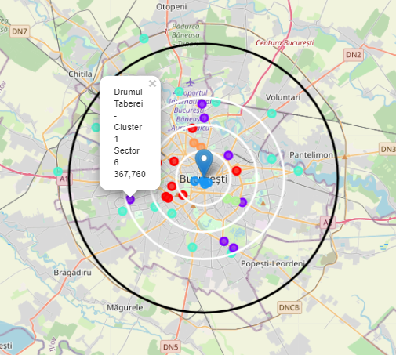
Conclusion
Possible Neighborhoods to set up a Turkish Restaurant:
Neighborhood 1 (Crângași - Cluster 3 Sector 6 367,760):
Cluster 3 would be the most suited place kept in mind the number of avenues available. However, competition will also be equal. Also Sector 6 one of top three highest populated sectors.
Neighborhood 2 (Drumul Taberei - Cluster 1 Sector 6 367,760):
Drumul Taberei is located on the West side and also is a part of highest populated sectors in Bucharest. Cluster 1 also has less restaurants and bus station. Keeping all the above pointers in mind this can also be considered as a venture.

Slide 13
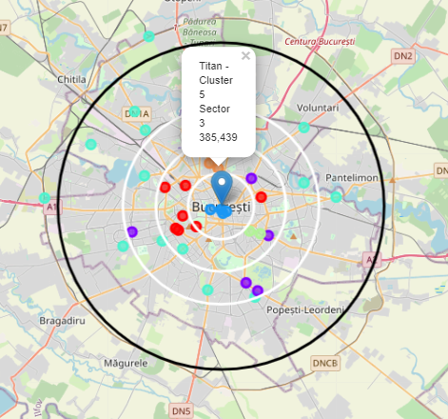
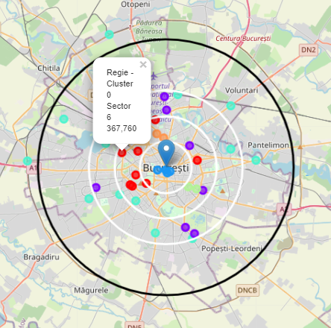
Conclusion (cntd.)
Neighborhood 3 (Titan - Cluster 5 Sector 3 385,439):
Titan is very near to the central western area and also is one of the highest populated sectors which means there is high demand and has no restaurants at all.
Neighborhood 4 (Regie - Cluster 0 Sector 6 367,760):
Regie is in the prime western location of Bucharest and is under the highest populated areas with very less avenues similar to Titan. So this place will also be a good place to start a Turkish restaurant.

